Slide 1



SP9T Cryogenic Switch Board
MEMSDuino
Lafe Spietz
NIST
2024

Slide 2
Abstract
This circuit board
MEMSDuino

Slide 3
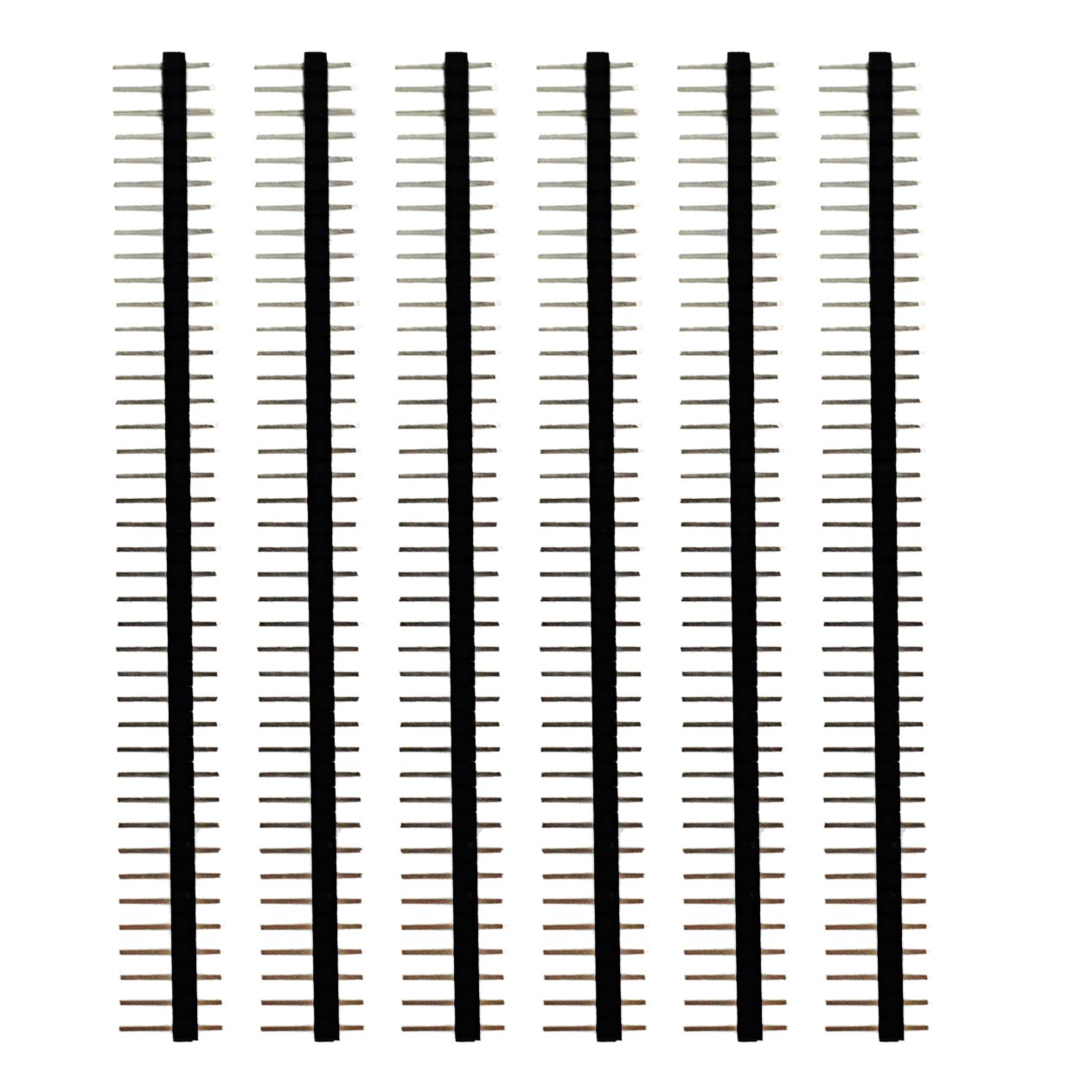
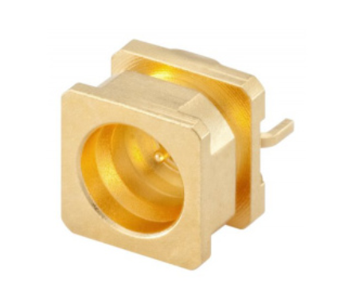
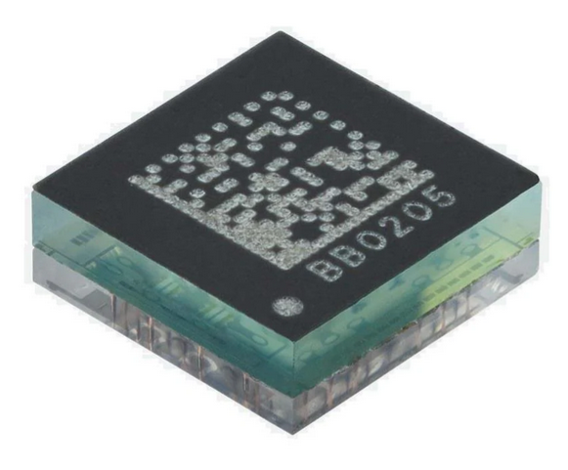
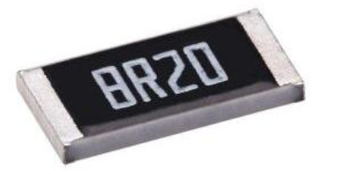
Parts
Rosenberger 19S201-40ML5 SMP Surface Mount Connector X9
0.1” headers, 40 pin strips x1
https://www.amazon.com/Header-Lystaii-Pin-Connector-Electronic/dp/B06ZZN8L9S/
https://www.digikey.com/en/products/detail/rosenberger/19S201-40ML5/7926834
Menlo Microwave
MM5130-03NDB-TR
TE Connectivity CPF0201B56K2E1 56 Kohm 0201 surface mount resistor, NiCr
https://www.digikey.com/en/products/detail/te-connectivity-passive-product/CPF0201B56K2E1/14007085
https://www.mouser.com/ProductDetail/Menlo-Micro/MM5130-03NDB-TR?qs=T%252BzbugeAwjibhPiaJVpzHA%3D%3D
MEMSDuino

Slide 4
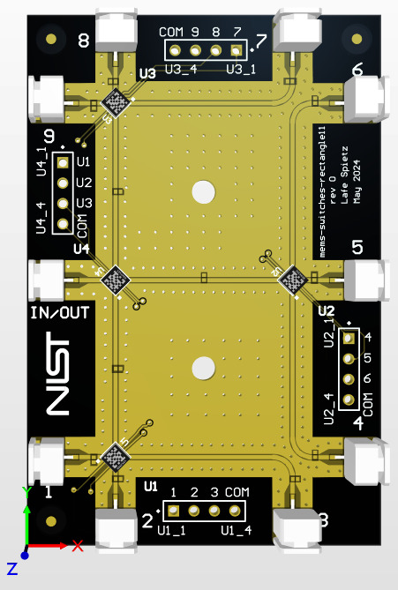
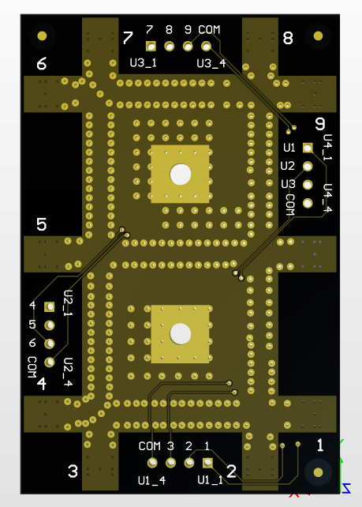
MEMSDuino

Slide 5
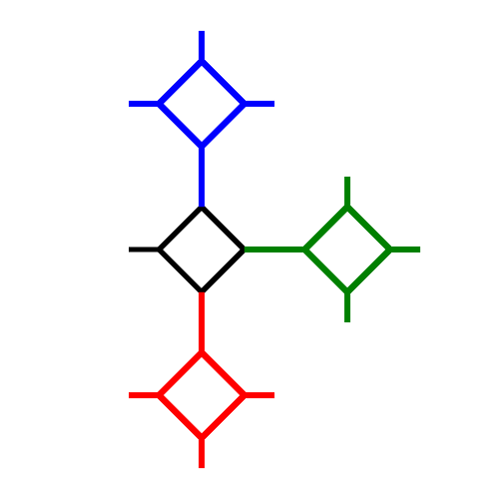
8
9
U3
7
6
IN/OUT
U4
U2
5
4
1
U3
3
2

Slide 6
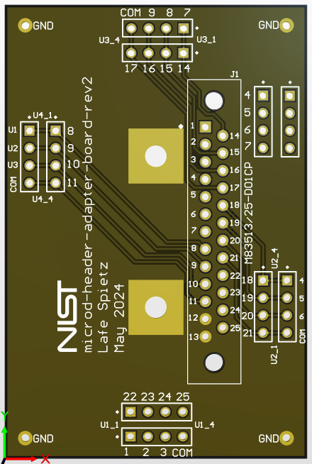
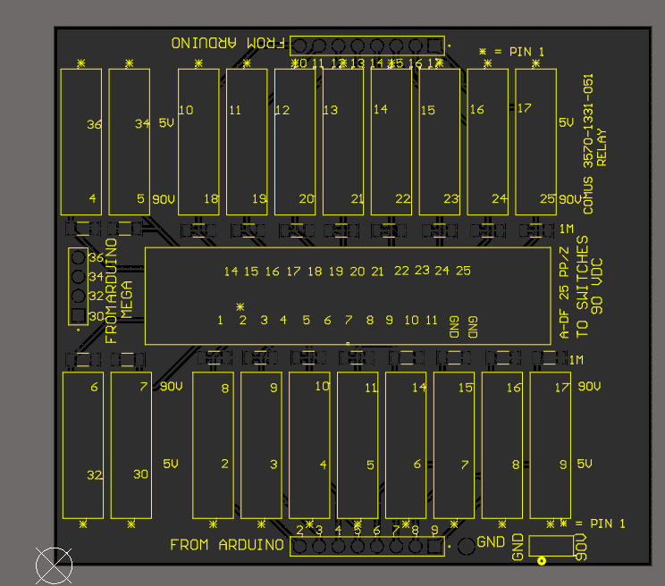

Slide 7
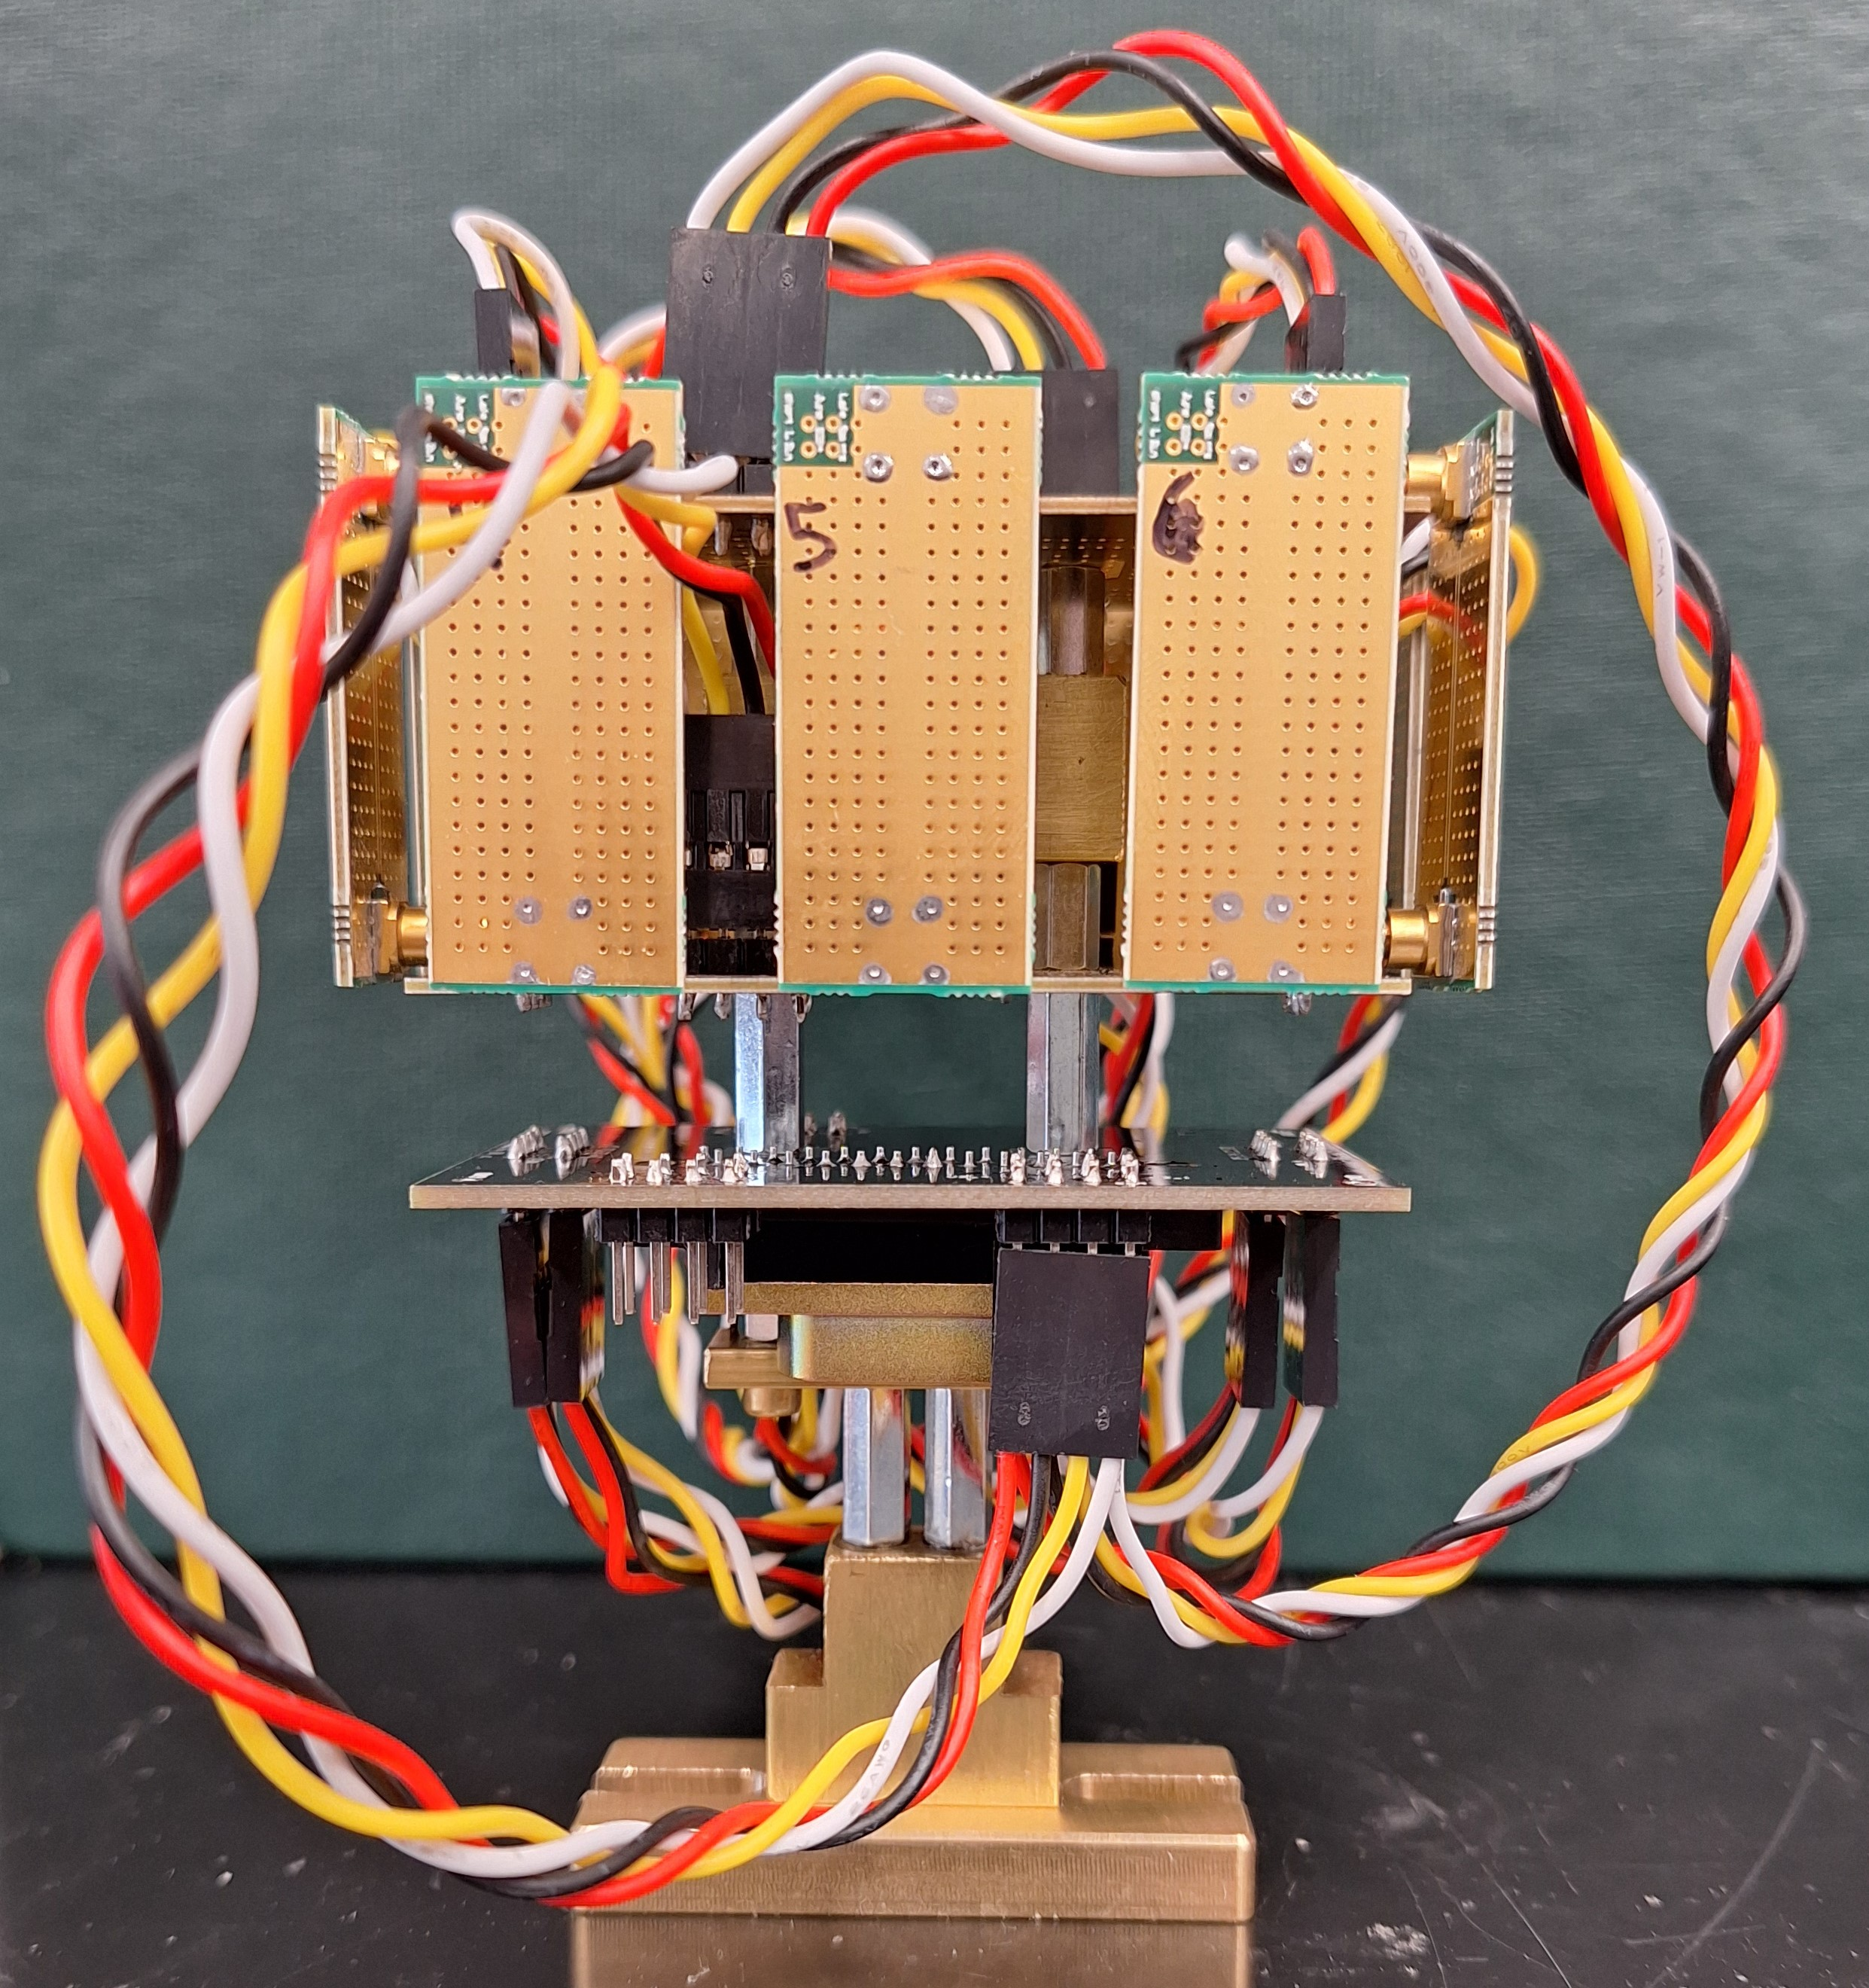
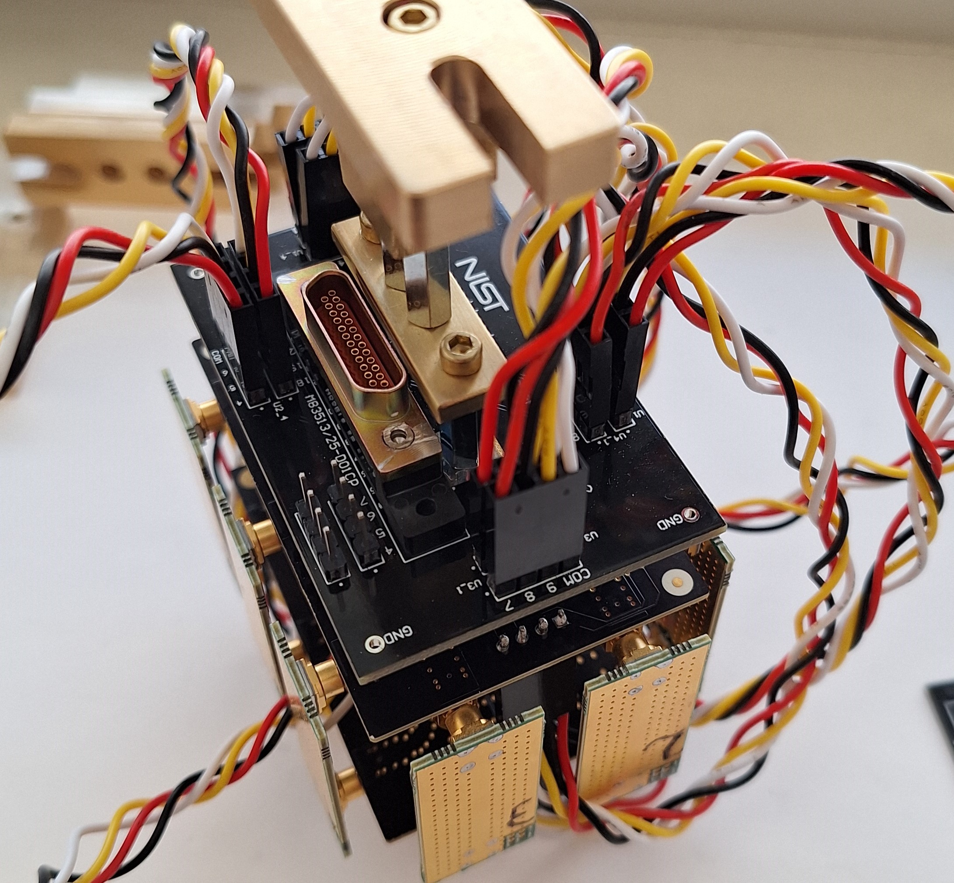
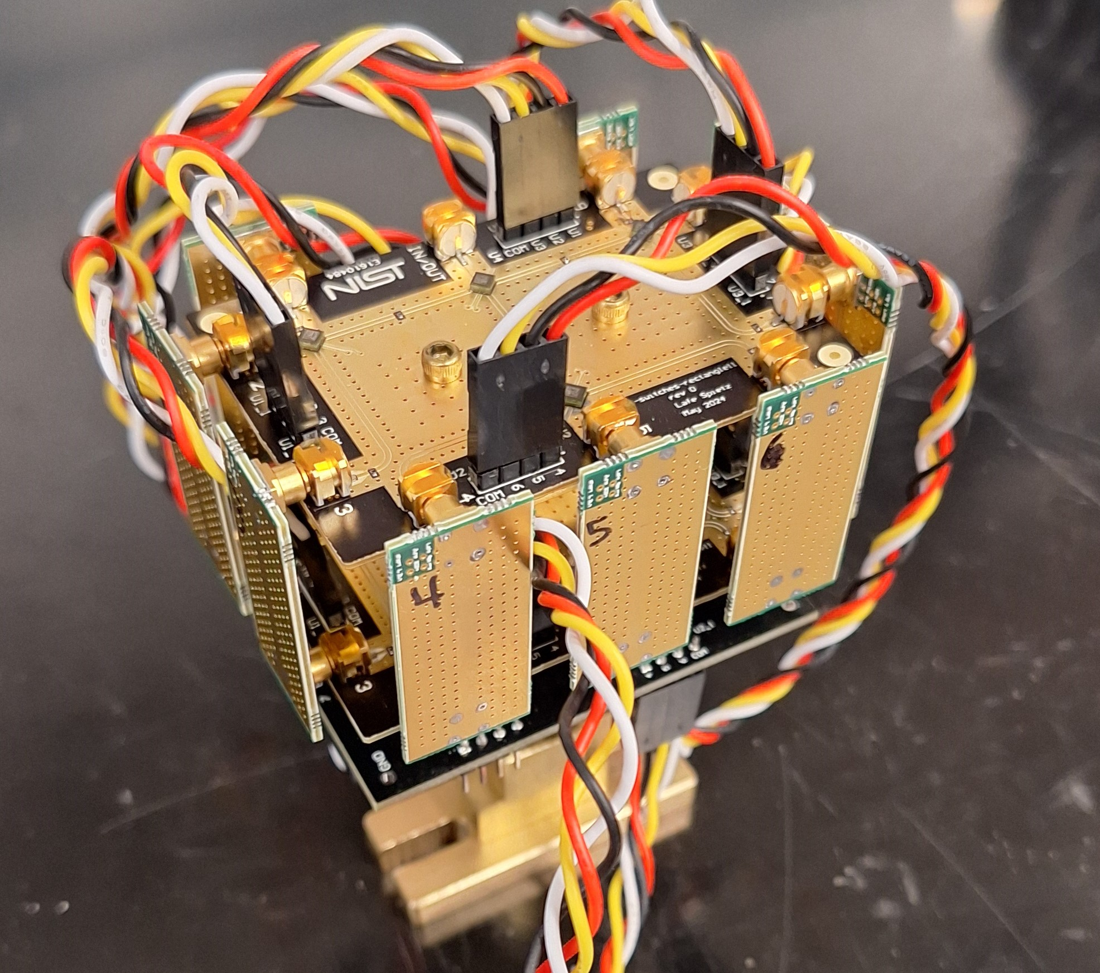

Slide 8
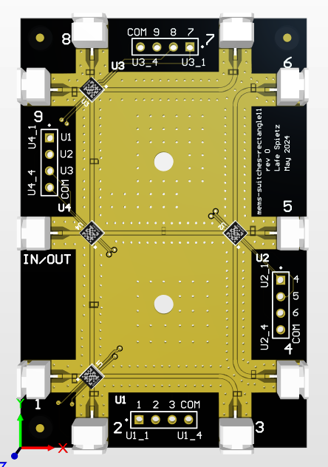
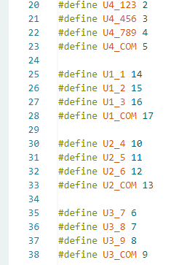

Slide 9
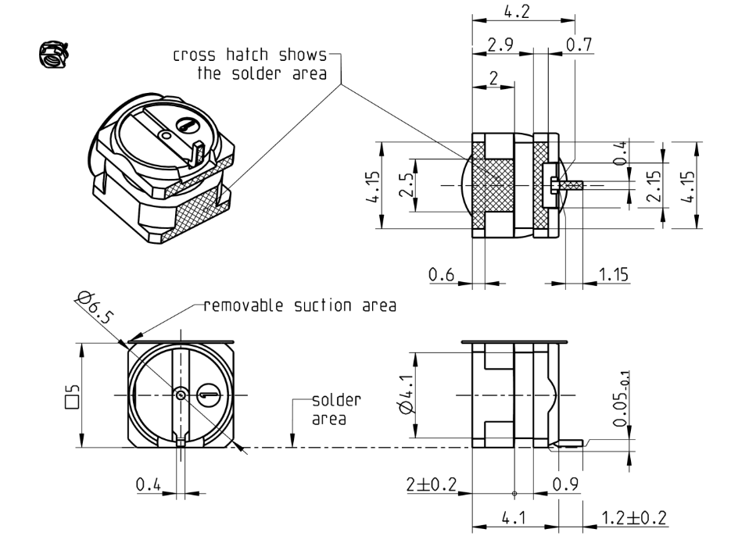
MEMSDuino

Slide 10
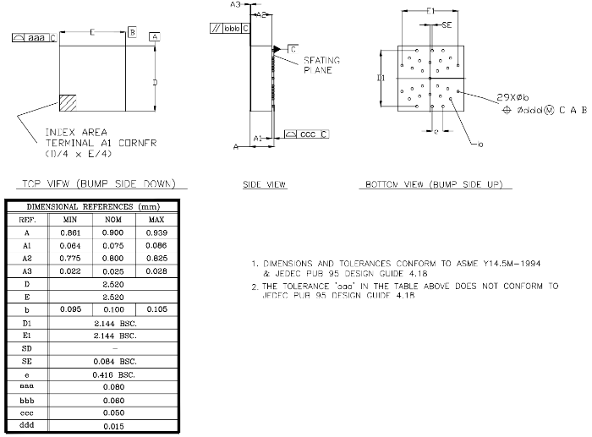
MEMSDuino

Slide 11
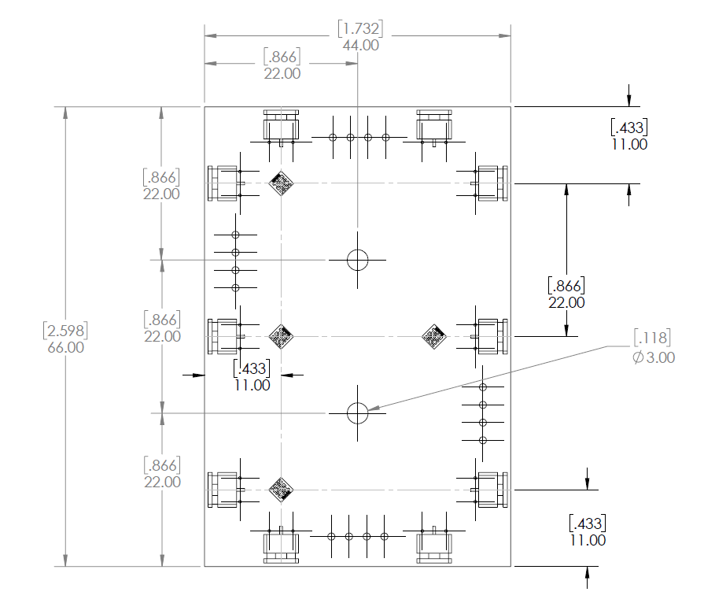
Mechanical Drawing
MEMSDuino

Slide 12
Conclusions:
MEMSDuino

